Slide 1
Condominium Buildings Presenting Wood Burning Exposures

Slide 2
The VMG Condominium Universe
The Vermont Mutual Group insures a significant volume of condominium properties. The nature of the occupancy can present itself in several forms across our regional landscape:
Primary homes
Secondary homes
Seasonal homes.

Slide 3
Seasonal and Secondary Exposures
Those owned as secondary or seasonal homes are often offered, either by the insured or a rental agent, as short term rentals
The majority of the short term rental activity revolves around the ski or foliage seasons.
It is common for many of the secondary or seasonal condominiums to present a wood burning exposure, either in the form of wood stoves or in the form of “zero clearance”/”factory built” fireplaces
While less common, these wood burning “zero clearance” fireplaces can also be found in condominiums in Central and Southern New England that are not associated with ski areas or foliage focused recreational activities

Slide 4
“Zero clearance”/”factory built” fireplaces
Traditional masonry fireplaces are built on site by a mason and are constructed of brick, stone, concrete block and/or tile. Their significant masonry mass provides structural strength and an insulating capacity to protect adjacent combustible construction
Zero clearance fireplaces consist of a pre-manufactured metal fire box, typically equipped with a firebrick lining, enclosed in a larger metal exterior shell/housing
The zero clearance fireplace relies on the insulating effect of the air space between the firebox and exterior shell/housing and maintenance of specific clearances to adjacent combustible construction to prevent ignition from dangerous temperature levels

Slide 5
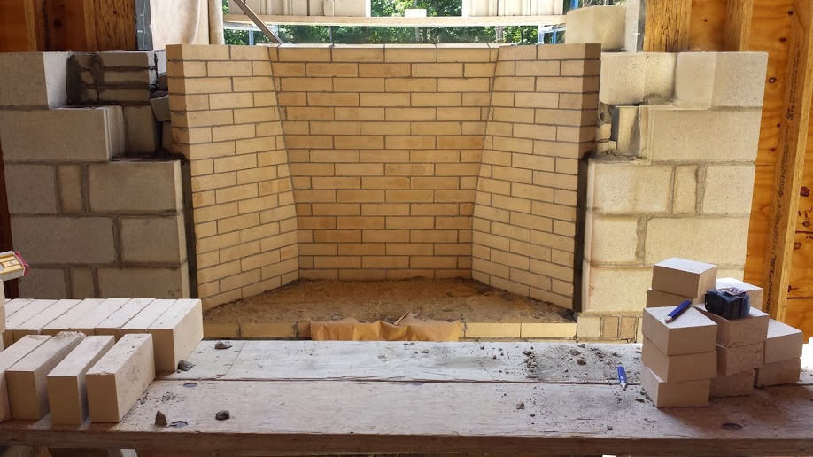
Masonry Fireplace Under Construction

Slide 6
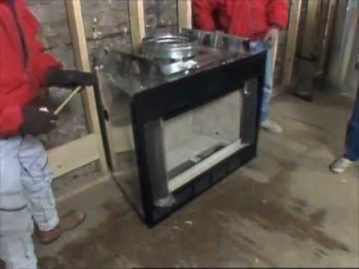
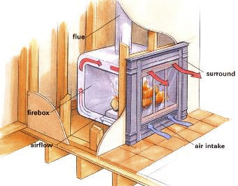
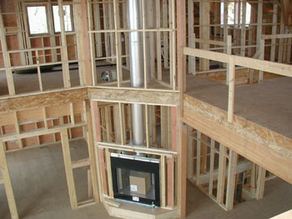
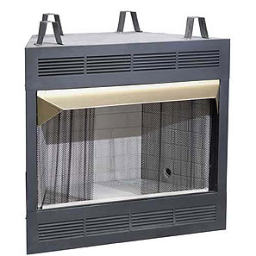
Factory Built/Zero Clearance Fireplace

Slide 7
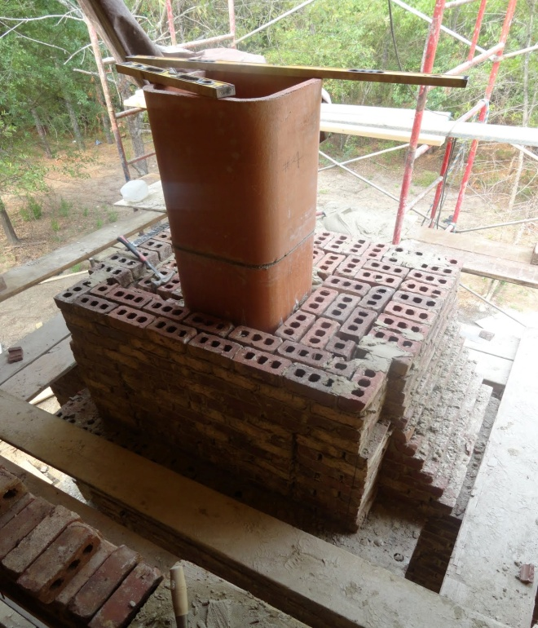
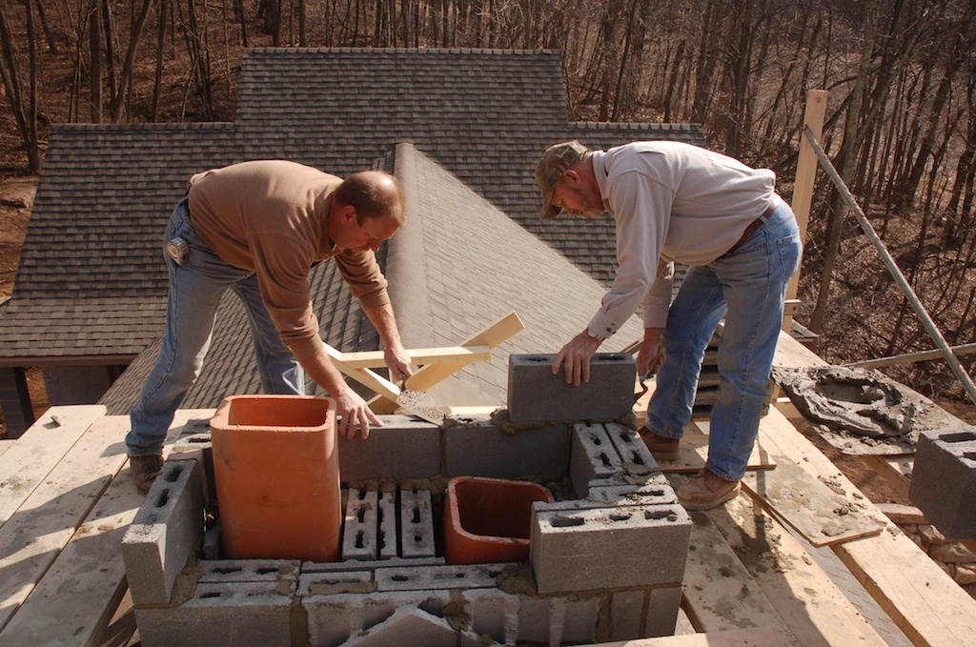
Venting of Masonry Fireplaces – Lined Brick Chimneys

Slide 8
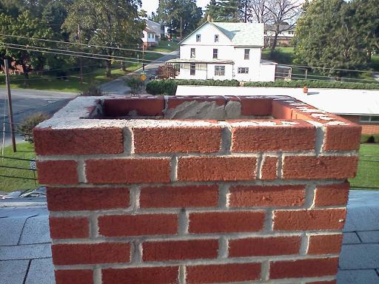
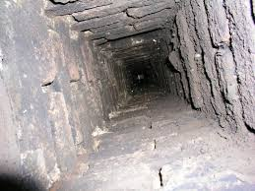
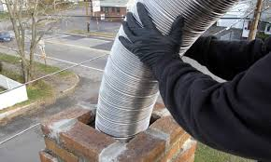
Venting of Masonry Fireplaces – Unlined Brick Chimneys

Slide 9
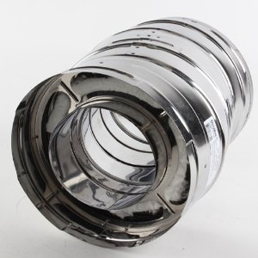
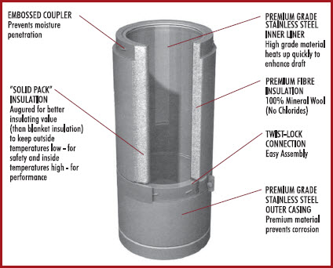
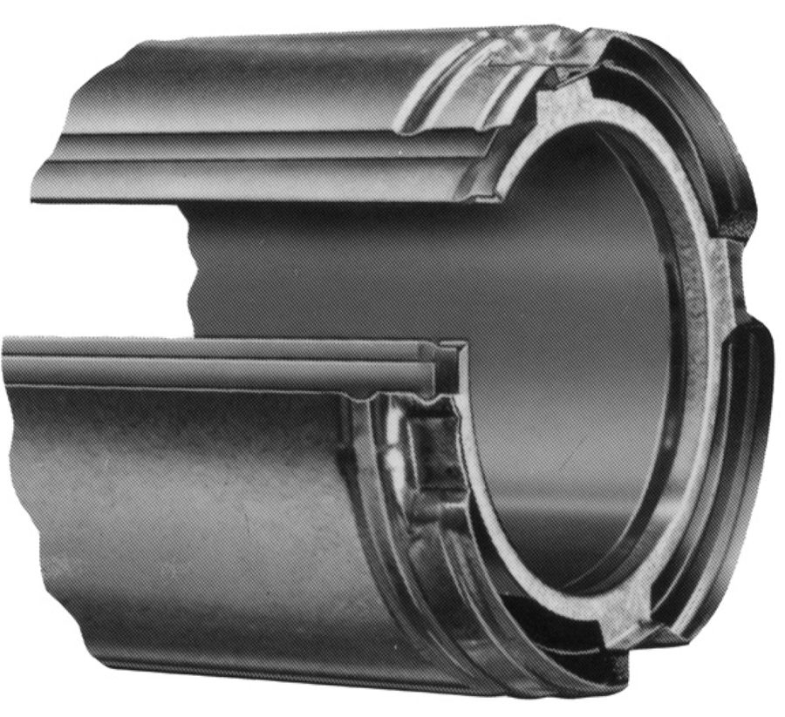
Class A Chimney Pipe

Slide 10
Venting of Zero Clearance Fireplaces
The zero clearance fireplace is vented by a Class A metal chimney
The Class A metal chimney assembly consists of two wall or three wall chimney pipe that is manufactured in 3-4 foot lengths that typically twist lock together to create a chimney of the desired length/height
This type of chimney relies on an insulating media and/or the insulating effect of the air spaces between the pipe walls to prevent transmission of dangerous levels of heat to the wood framing of the chase that encloses the chimney.

Slide 11
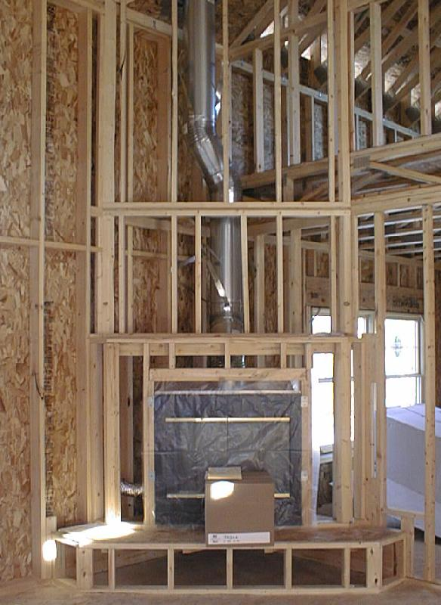
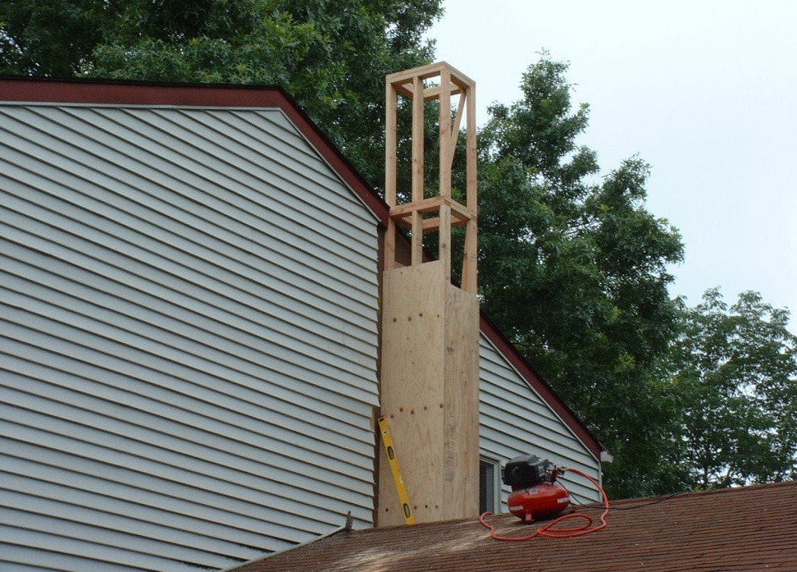
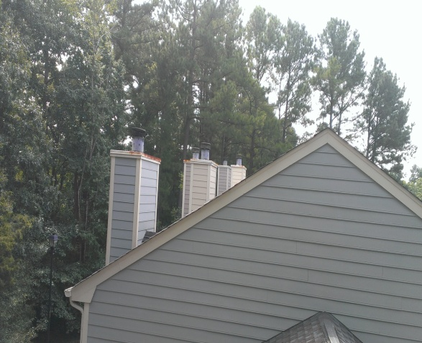
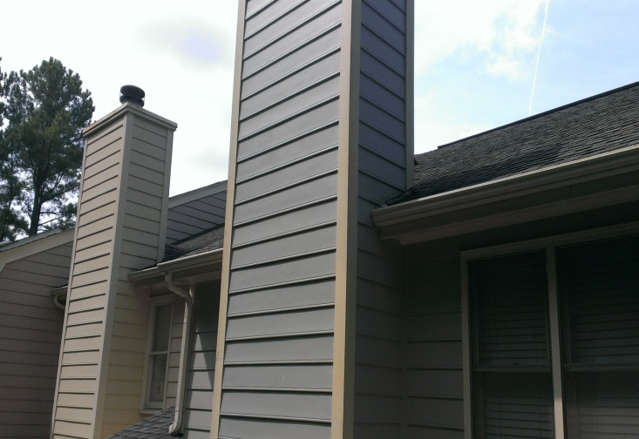
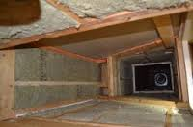
Venting of Zero Clearance Fireplaces

Slide 12
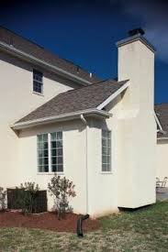
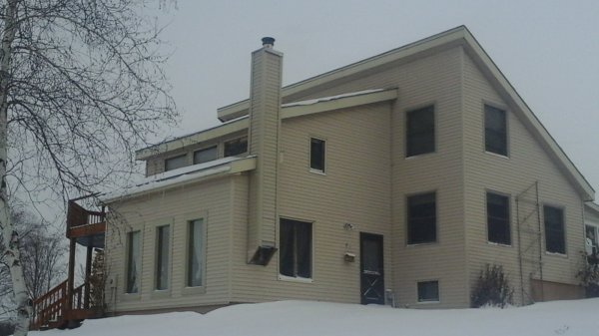
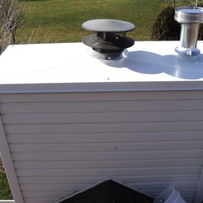
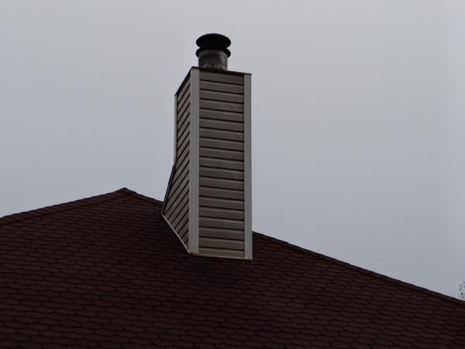
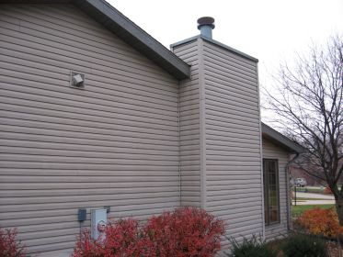
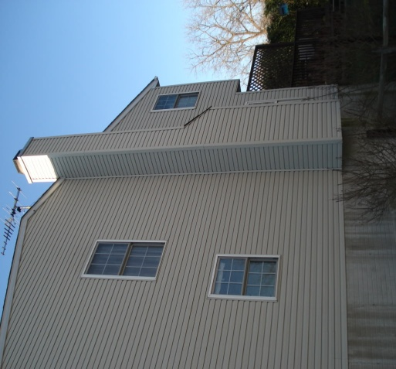
Visual Clues to the Potential Presence of Zero Clearance Fireplaces or Wood Stoves

Slide 13
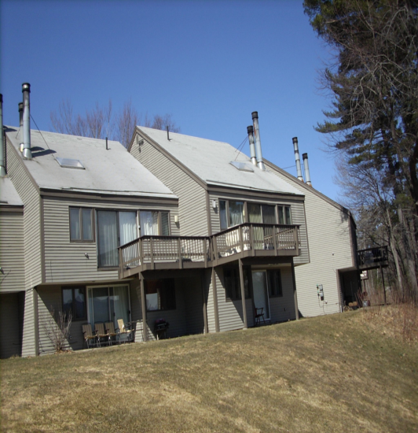
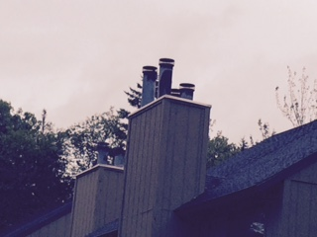
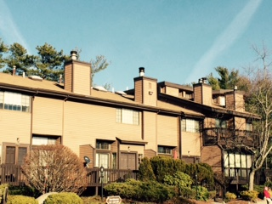
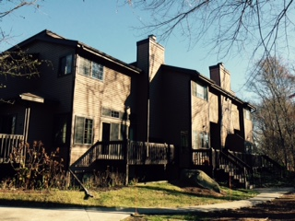
Visual Clues to the Potential Presence of Zero Clearance Fireplaces or Wood Stoves

Slide 14
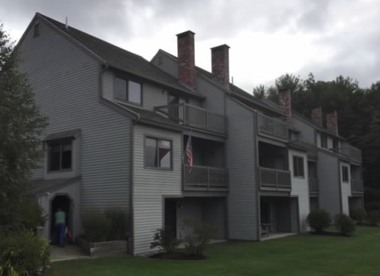
Masonry Chimneys Indicate Conventional Masonry/Non Zero Clearance Fireplaces

Slide 15
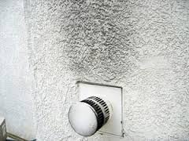
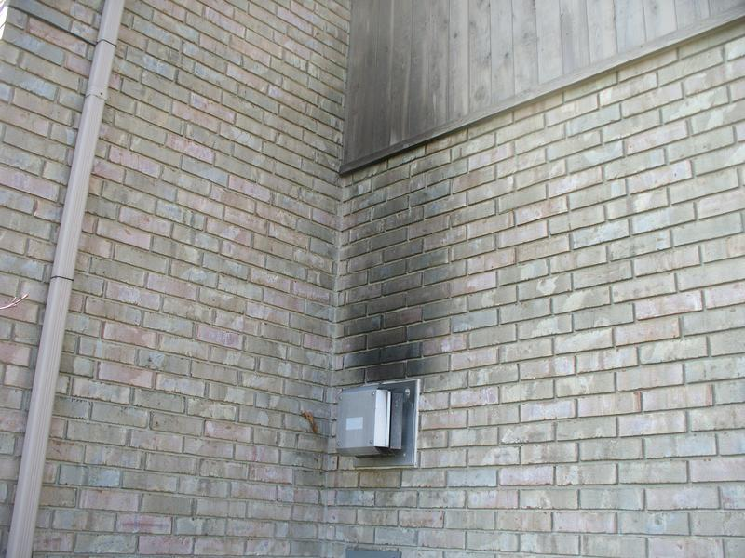
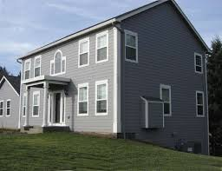
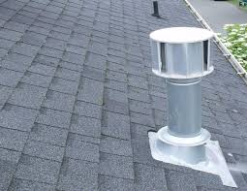
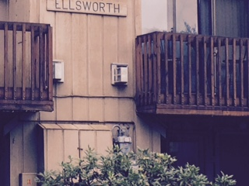
Gas Fireplace Venting

Slide 16
The Realities of Zero Clearance Fireplaces
The nature of their construction and venting lends itself far more appropriately to a limited usage pattern and these appliances are in no way intended to be used as a primary heating source
Condominium Associations can vary substantially in the manner in which they approach the issue of annual cleaning and inspection of zero clearance fireplace and wood stove chimneys
When the issue of chimney cleaning and inspection is left in the hands of the individual unit owners, typically the consistency with which chimneys are cleaned and inspected suffers substantially.
Some Condominium Associations maintain supplies of cordwood on site for use by unit owners and during extended periods of excessively cold weather this can promote excessive use and over-firing of wood stoves
Condominium Associations vary substantially with regard to whether they provide a designated location and receptacle for disposal of ashes and cinders
If the Association allows short term rentals of units the result can be large numbers of renters who are unfamiliar with wood burning appliances and who are more prone to over firing of the zero clearance fireplace

Slide 17
Zero Clearance Fireplace As A Potential Fire Loss Source
A condominium association lacking a comprehensive protocol to ensure the annual cleaning and inspection of chimneys serving wood stoves or wood burning zero clearance fireplaces can result in creosote accumulating on the inside walls of chimneys
Accumulations of creosote are easily ignitable and can result in chimney fires
Most Class A chimneys are designed and rated for maximum flue gas temperatures of 1,000 degrees
A normal wood fire in a wood stove or fireplace will produce flue gas temperatures in the 600-900 degree range
A chimney fire of any consequence can develop temperatures as high as 2000 – 2,500 degrees
Chimney fires can destroy the structural integrity of Class A chimneys – particularly at the point at which sections of pipe are joined together and this damage can allow the release of hot flue gases from the chimney

Slide 18
Chimney Fire Realities
Not all chimney fires are detected
This is particularly true when the wood fire appliance is being operated by someone unfamiliar with burning wood
Chimneys can be subject to the destructive effects of multiple undetected chimney fires
This cumulative trauma can result in ignition of adjacent combustible construction due to radiated heat from chimney fires or release of hot flue gases due to a breach in the chimney wall or chimney joint

Slide 19
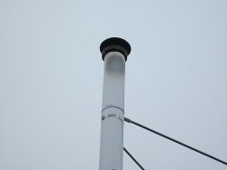
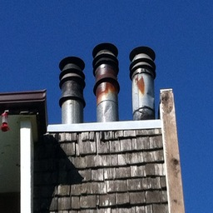

Scorch Marks on the Exterior Walls of Class A Chimneys are Evidence of Past Chimney Fires

Slide 20
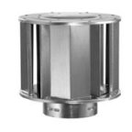
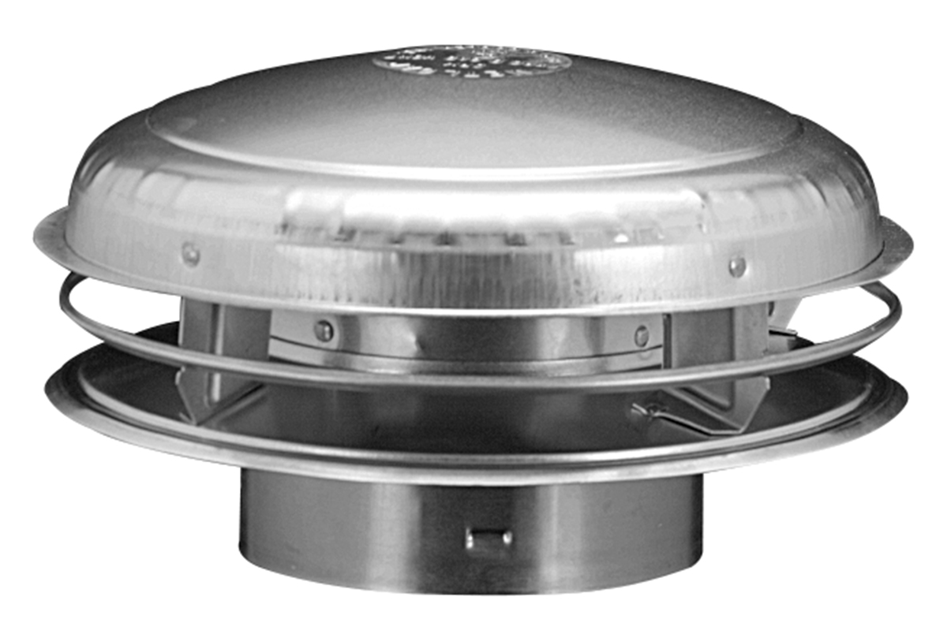
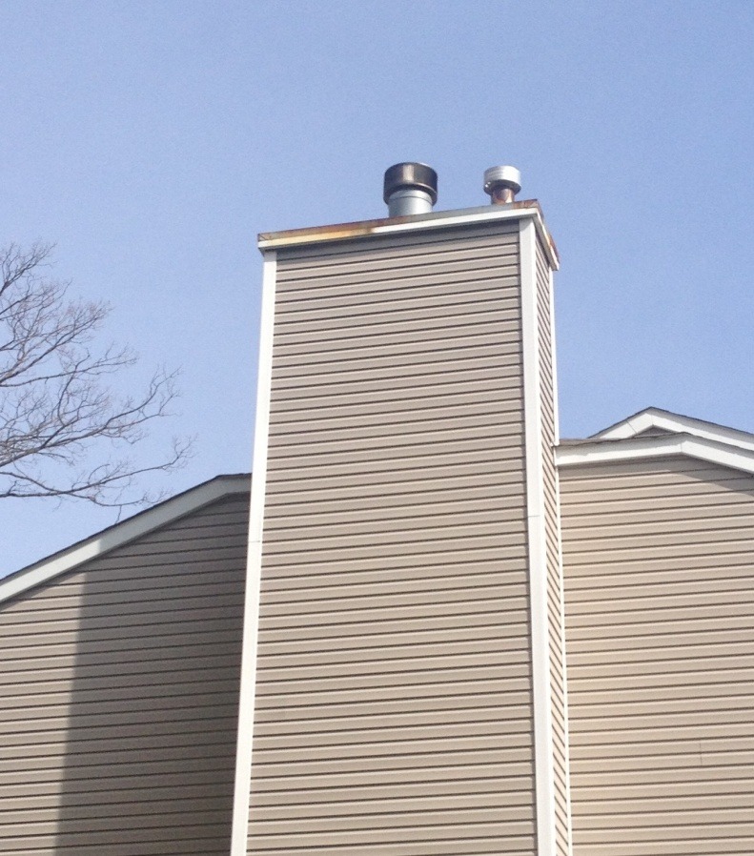
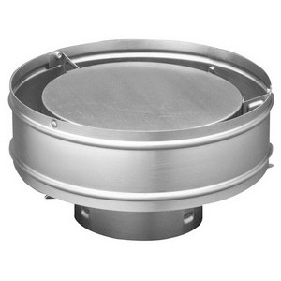
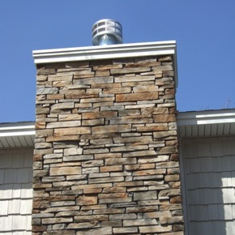
Type B (Gas Fired) Vent Caps

Slide 21
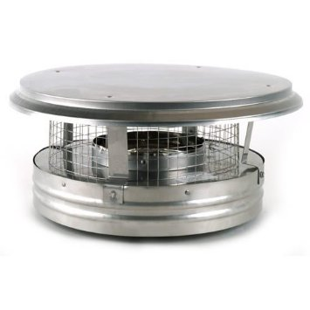
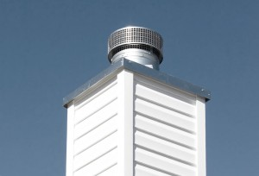
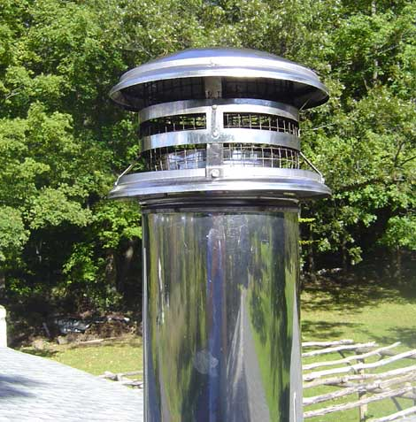
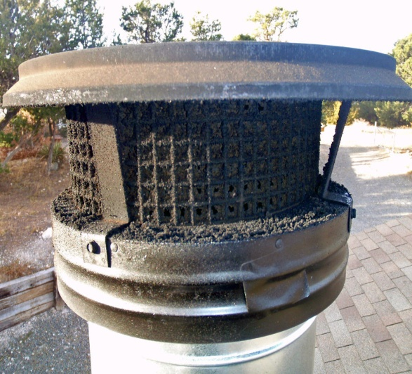
Class A (Wood Fired) Chimney Caps

Slide 22
Chimney Cleaning and Inspection – Level I
NFPA 211 - Standard for Chimneys, Fireplaces, Vents and Solid Fuel Burning Appliances
Level I Inspection - Examine the readily accessible portions of the chimney exterior, interior and accessible portions of the appliance and the chimney connection. Evaluating the basic soundness of the chimney structure and flue as well as the basic appliance installation and connections. Verify the chimney is free of obstruction and combustible deposits.

Slide 23
Chimney Cleaning and Inspection – Level II
Level II Inspection - A Level II inspection includes everything in a Level 1 inspection, plus the accessible portions of the chimney exterior and interior including attics, crawl spaces and basements. It will address proper clearances from combustibles in accessible locations.
A Level II inspection shall also include a visual inspection by video scanning or other means in order to examine the internal surfaces and joints of all flue liners incorporated within the chimney

Slide 24
Chimney Cleaning and Inspection – Level III
A Level 3 inspection includes all the areas and items checked in a Level 1 and a Level 2 inspection
It also includes the removal of certain components of the building or chimney where necessary. Removal of components (i.e., chimney crown, interior chimney wall) shall be required only when necessary to gain access to areas that are the subject of the inspection.
When serious hazards are suspected, a Level 3 inspection may well be required to determine the condition of the chimney system

Slide 25
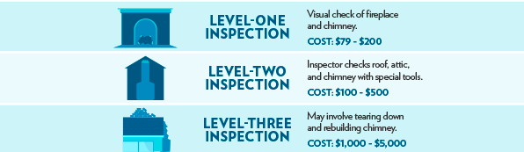
Comparative Costs Of Level I, II and III Chimney Inspections

